Slide 1
Database System
Saba Ghani
FAST-NU
Chiniot-Faisalabad campus

Slide 2
Week 2
Data models, Schema and Instances, Three-Schema architecture, Data Independence
Database languages and interface
Database users
The Database system Environment, Centralized and client/Server architecture for DBMSs.
Classification of DBMS

Slide 3
Data Independence
The three-schema architecture can also be used to explain the concept of data independence
Can be defined as the capacity to change the schema at one level of a database system without having to change the schema at the next higher level.
Data abstraction refers to hiding the of details of data organization and storage.
Data abstraction generally refers to the suppression of details of data organization and storage, and the highlighting of the essential features for an improved understanding of data.

Slide 4
Data Independence
Data Independence
Physical representation and location of data and the use of that data are separated
The application doesn’t need to know how or where the database has stored the data, but just how to ask for it
Moving a database from one DBMS to another should not have a material effect on application program
Recording, adding fields, etc. in the database should not affect applications

Slide 5
Data Independence
1. Logical data independence
The ability to modify the conceptual scheme without having to change external schema or application program.
Usually done when logical structure of database is altered (change constraints, expand and reduce data base).
2. Physical data independence
The ability to modify the physical scheme without having to change conceptual schema.
Internal schema may be needed to reorganize physical files and improve performance.
For example by creating additional access structure- to improve the performance of update and retrieval.

Slide 6
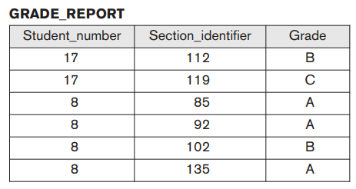
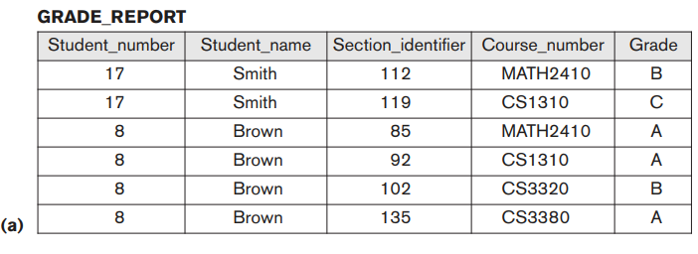
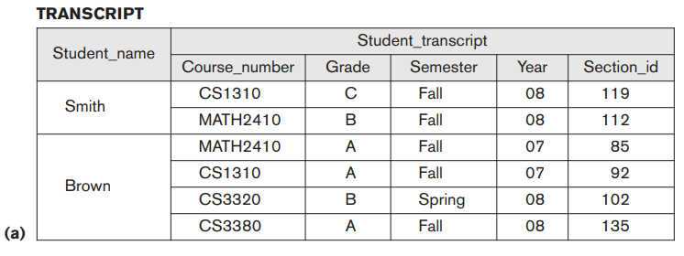
Logical data independence

Slide 7
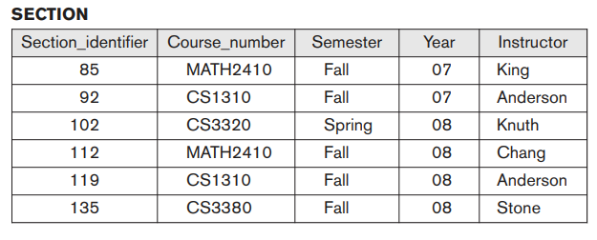
Physical data independence
For example, providing an access path to improve retrieval speed of SECTION records by semester and year should not require a query such as list all sections offered in fall 2008 to be changed, although the query would be executed more efficiently by the DBMS by utilizing the new access path

Slide 8
Database languages
Once the design of a database is completed and a DBMS is chosen to implement the database, the first step is to specify conceptual and internal schemas for the database and any mappings between the two.
DDL – the data definition language, used by database developer to define the conceptual and internal schemas.
The DBMS has a DDL compiler to process DDL statements in order to identify the schema constructs, and to store the description in the catalogue.
Create command is used create table; Alter command is used to alter table, columns, constraints and data types. Drop command is used to drop a column, database, table or constraints
SDL , Storage definition Language Used to specify internal schema. Mapping between two schema. Today there is no specified language that perform the role of SDL.
VDL-View Definition Language Define the external view over schema. Currently DDL used to define both conceptual and external schemas

Slide 9
Database languages
DML , Data manipulation language
is used to manipulate database. Manipulation operation includes insertion, deletion and updating and selection of data in database
DCL , Data Control language: USE to assign privileges to different user to access database objects
A typical example of a comprehensive database language is the SQL relational database language, which represents a combination of DDL, VDL, and DML, as well as statements for constraint specification, schema evolution, and many other features

Slide 10
Architectures for DBMSs
Centralized DBMS Architecture
Used mainframes to provide main processing for user application programs, and DBMS functionality
User accessed systems via computer terminals that only provided display capabilities, with no processing capabilities.
All processing performed remotely on the computer system, and only display information was sent to the terminals, connected via a network.

Slide 11
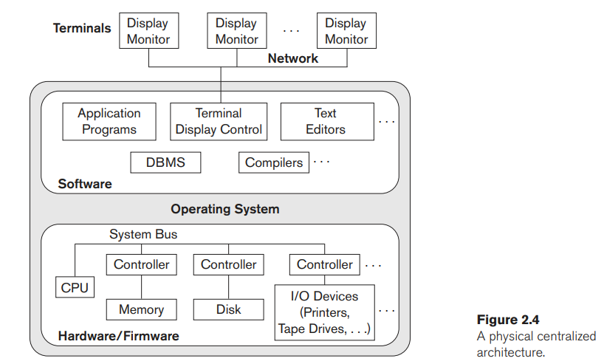
Centralized Architecture for DBMSs

Slide 12
Client Server Architecture for DBMSs
Client Server Architecture
Server – machine that provides services to client machines such as file access, printing, and database access.
Define specialized servers with specific functionalities (file servers, print servers, web servers, database servers)
Many client machines can access resources provided by specialized server.
Client – a user machine that provides user interface capabilities and local processing.
Client machines provide user with the appropriate interfaces to utilize servers, as well as with local processing power to run local applications.
Some machines are client sites, with client software installed.

Slide 13
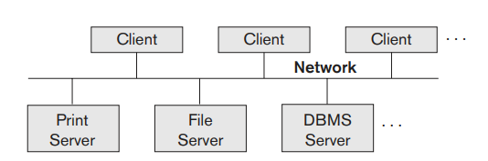
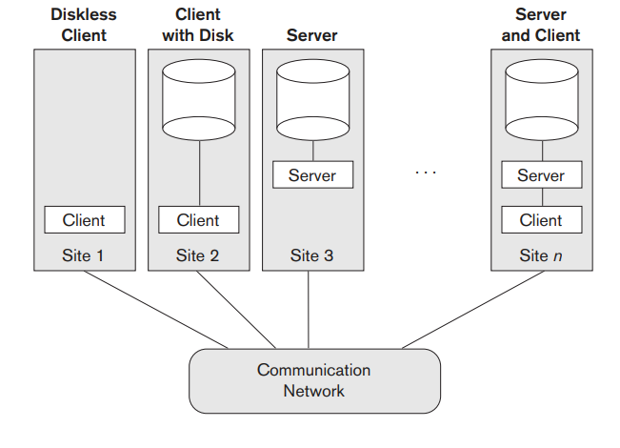
Client Server Architecture for DBMSs
Notes:
Two main types of basic DBMS architectures were created on this underlying client/server framework: two-tier and three-tier

Slide 14
Two Tier Client-Server Architecture
The system components that were first moved to the client side were the user interface and application programs.
Because SQL provided a standard language for RDBMSs, this created a logical dividing point between client and server.
Hence, the query and transaction functionality related to SQL processing remained on the server side
A standard called ODBC (Open Database Connectivity ) provides an Application program interface (API) allow client-side programs to call the DBMS.
A client program may connect to several DBMSs.
Other variations of clients are also possible: e.g., in some DBMSs, more functionality is transferred to clients including data dictionary functions, optimization and recovery across multiple servers, etc. In such situations the server may be called the Data Server.
Notes:
The architectures described here are called two-tier architectures because the software components are distributed over two systems: client and server. The advantages of this architecture are its simplicity and seamless compatibility with existing systems. The emergence of the Web changed the roles of clients and servers, leading to the three-tier architecture.

Slide 15
Three Tier Client-Server Architecture
Common for Web applications
Intermediate Layer called Application Server or Web Server:
stores the web connectivity software and the rules and business logic (constraints) part of the application used to access the right amount of data from the database server
acts like a channel for sending partially processed data between the database server and the client.
Additional Features-
Security:
encrypt the data at the server before transmission
decrypt data at the client

Slide 16
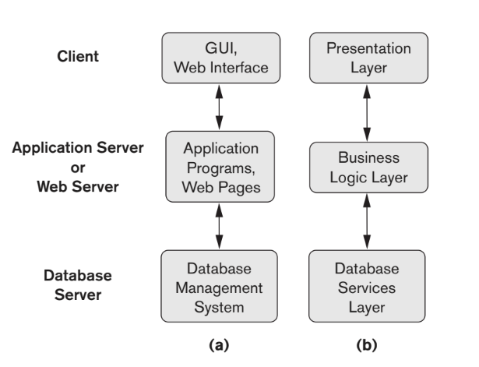
Three Tier Client-Server Architecture

Slide 17
Classification of DBMSs
Several criteria can be used to classify DBMSs.
Data Model Classification
Relational data model
Object data model
Hierarchical data model
Network data model
Object relational data model
Number of Users
Single User systems
Multi User systems
Notes:
The first is the data model on which the DBMS is based.

Slide 18
Classification of DBMSs
Number of Sites
The third criterion is the number of sites over which the database is distributed
Centralized – data is stored at single site.
Distributes – database and DBMS software stored over many sites connected by network
Homogeneous – use same DBMS software at multiple sites.
Heterogeneous- use different DBMS software at multiple sites.

Slide 19
ASSIGNMENT 01 GOOGLE CLASSROOM Submission Portal shall be closed after deadline

